Slide 1



AquaPure
KILIMANI,MURINGA RD
0700 000 000
BILHA WANJIKU | NAIMA HASSAN |PAULINE BROWN

Slide 2
40%
WATER DEMAND
790000
WATER SUPPLIED
NAIROBIANS AFFECTED BY WATER SCARCITY
526000

Slide 3

Freedom
Trust

Slide 4
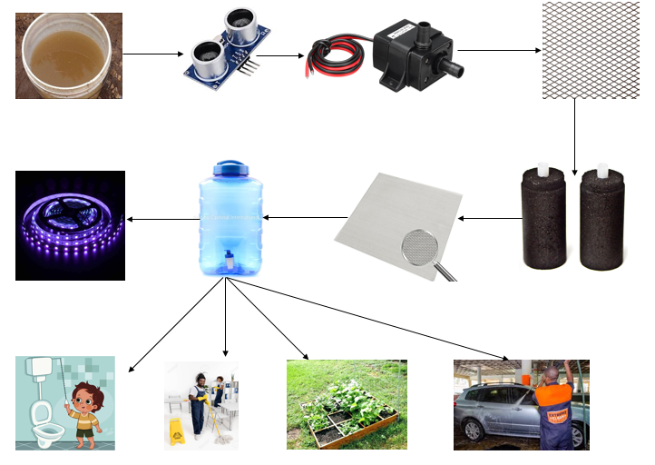

Slide 5

DISTRIBUTION MODEL

Slide 6

MARKET PLAN

Slide 7
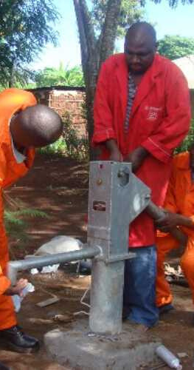
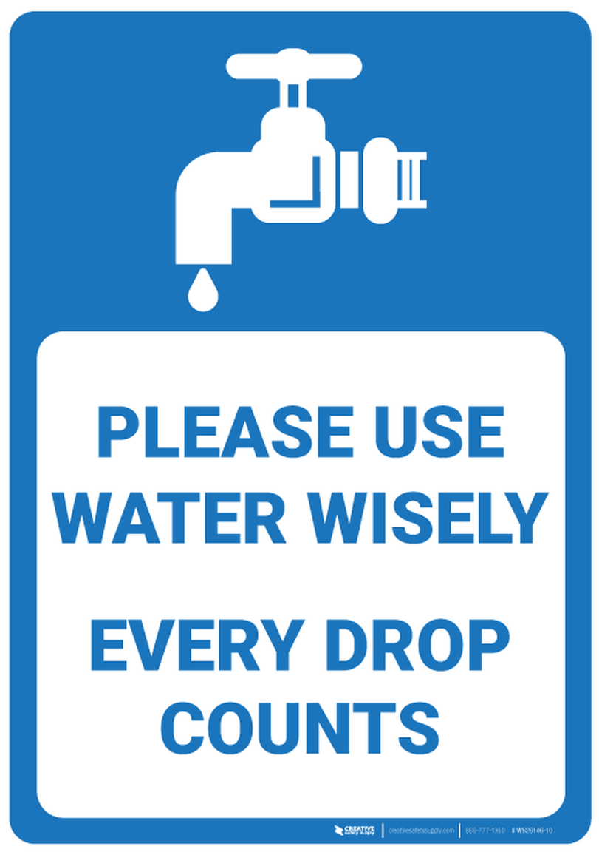

COMPETITIVE ANALYSIS

Slide 8
TEAM
NAIMA HASSAN
PAULINE BROWN
BILHA WANJIKU

Slide 9
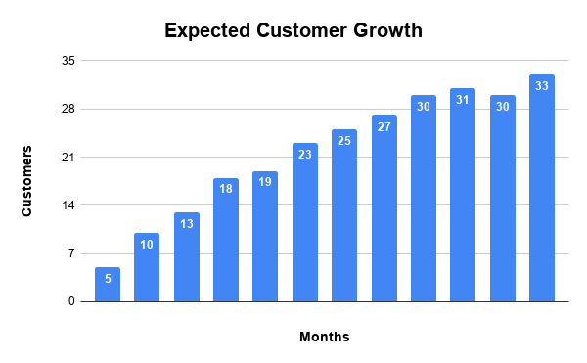

Slide 10
NEEDED FUNDING
(5 MONTHS)
KSH 2.5M
KSH 80,000 PER PRODUCT AND FREE INSTALLATION

Slide 11


